Slide 1
Information For Parents

Slide 2
Our School Day
Children are welcome to arrive at the school from 9.10am each morning. No supervision is provided before this time. Infants finish at 2pm and all other classes finish at 3pm.
Any child going on the school bus will leave the school at 1.50pm each day for Junior & Senior Infants & 2.50pm for all other classes.

Slide 3
Our Junior Infants Transition Timetable
Day 1 is Wednesday 30th Aug : 9:20am – 12noon
Day 2 & 3
Week 2 Monday 4th-Friday 8th : 9.20am – 12noon

Slide 4
Uniform
Junior Infants should
wear shoes with Velcro.
Label all items
of clothing
Girls | Boys
Navy Trousers/Pinafore/Skirt Navy V-necked Jumper/Cardigan with school crest Blue Shirt Red Tie | Navy Trousers Navy V-necked Jumper with school crest Blue Shirt Red Tie
Children can wear black shoes or dark coloured trainers. | Children can wear black shoes or dark coloured trainers.
PE Uniform
Navy tracksuit bottoms
Navy sweatshirt
Blue t-shirt
PE days will be decided in September. On these days your child should wear their PE uniform

Slide 5
Communication in Scoil Eoin Baiste
We have a school app which all parents will get access to. This is our main method of communication with parents. Parents will be sent instructions on accessing the app.
As well as the app the school have an active website www.carrigartns.ie and a Facebook page.
Parents are also emailed throughout the school year if there are a number of documents for parents to read.
We encourage good communication with parents so if you have any queries or concerns we would ask that you contact the school office. If you need to speak to your child’s teacher you can leave a message for their teacher to contact you. Unless it is an urgent matter teachers will contact you after school hours.

Slide 6
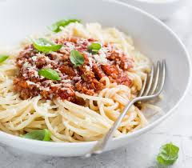
Lunch
Lunches are provided for all children in Scoil Eoin Baiste. From September we will be getting hot meals for all children which will be served at the second break. The children will receive a snack at the first break.
The school will contact all parents with a link to order lunches for their children.
We have a strict healthy eating code in the school and encourage only healthy foods and snacks.
Children can purchase a small snack in the school each Friday from the Siopa.

Slide 7
Points to note in Scoil Eoin Baiste
School bags- Ensure your child’s school bag is big enough to fit an A4 folder.
Invitations- Children are only permitted to bring invitations into school if they have an invite for all the girls/boys in their class group.
Insurance- Allianz Insurance offers a Pupil Personal Accident Insurance. Anyone who wishes to avail of this cover can contact the school office for more information.

Slide 8
Who will be working with my child?
Your child’s class teacher is Mrs Mc Laughlin.
In Scoil Eoin Baiste we use special education teachers to provide support in the form of Early Intervention in the infant classes.
From time to time special needs assistants will be assisting in your child’s classroom also.
During the school year we will ask for parent volunteers to assist us therefore we would kindly ask any parents who would be available during school hours to get Garda Vetting for the school.

Slide 9
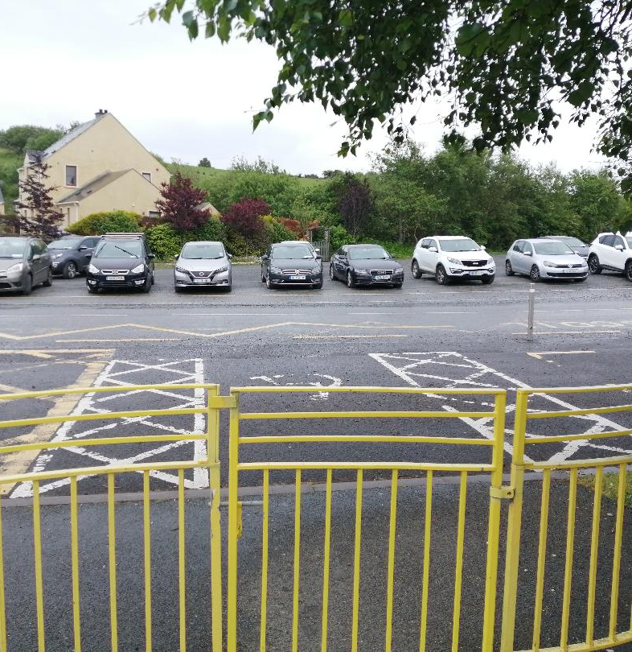
Parking
All parents, except for parents using the disabled parking spots, must park across the road from the school.
Children must be accompanied across the road, at the crossing, to the school gate.
At the end of the school day, all classes will line up at the yellow line close to the school gate. Only when a teacher sees who is collecting each child will they be allowed to go.

Slide 10
Attendance
Good attendance is vital for children to thrive socially and educationally.
If your child is absent for any reason please fill in an absence note on the school website or send a written note of explanation to the class teacher on their return.
If a child is absent for 20 days or more the school is obliged to report this to the National Educational Welfare Board.
If your child will be arriving late for school or has to leave school early for any reason please ring the school office or email the school to notify us.

Slide 11
Child Protection

