Slide 1
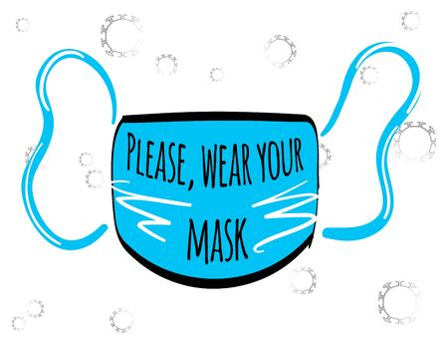
Our return to school January 6th 2021
Points to Note
Do not send your child to school if they are displaying any symptoms of Covid-19 or are a close contact.
Children are free to wear tracksuit bottoms and extra jumpers/hoodies as we try to ventilate classrooms as much as possible. Children will also have more outdoor movement breaks.
Children from 3rd -6th class to continue to wear masks every day.
Please return all books sent home before Christmas.
Parents of children who develop symptoms whilst in school will be contacted immediately to collect their child.
A reminder that a number of children in the school have nut allergies. Nuts or nut containing products are not allowed.

