Slide 1
May Newsletter
We have a very busy few weeks ahead of us between now and the end of the school year. This newsletter will have all the information needed to keep up to date with what is planned.
Standardised Testing
Testing will be taking place over the next few weeks.
Congratulations
Congratulations to the children in 2nd class, 5th and 6th class who recently made their First Communion and Confirmation. We hope you all really enjoyed your special day.
.
School Mass
We would like to invite you all to celebrate our end of year mass on Friday 16th June at 10am.

Slide 2
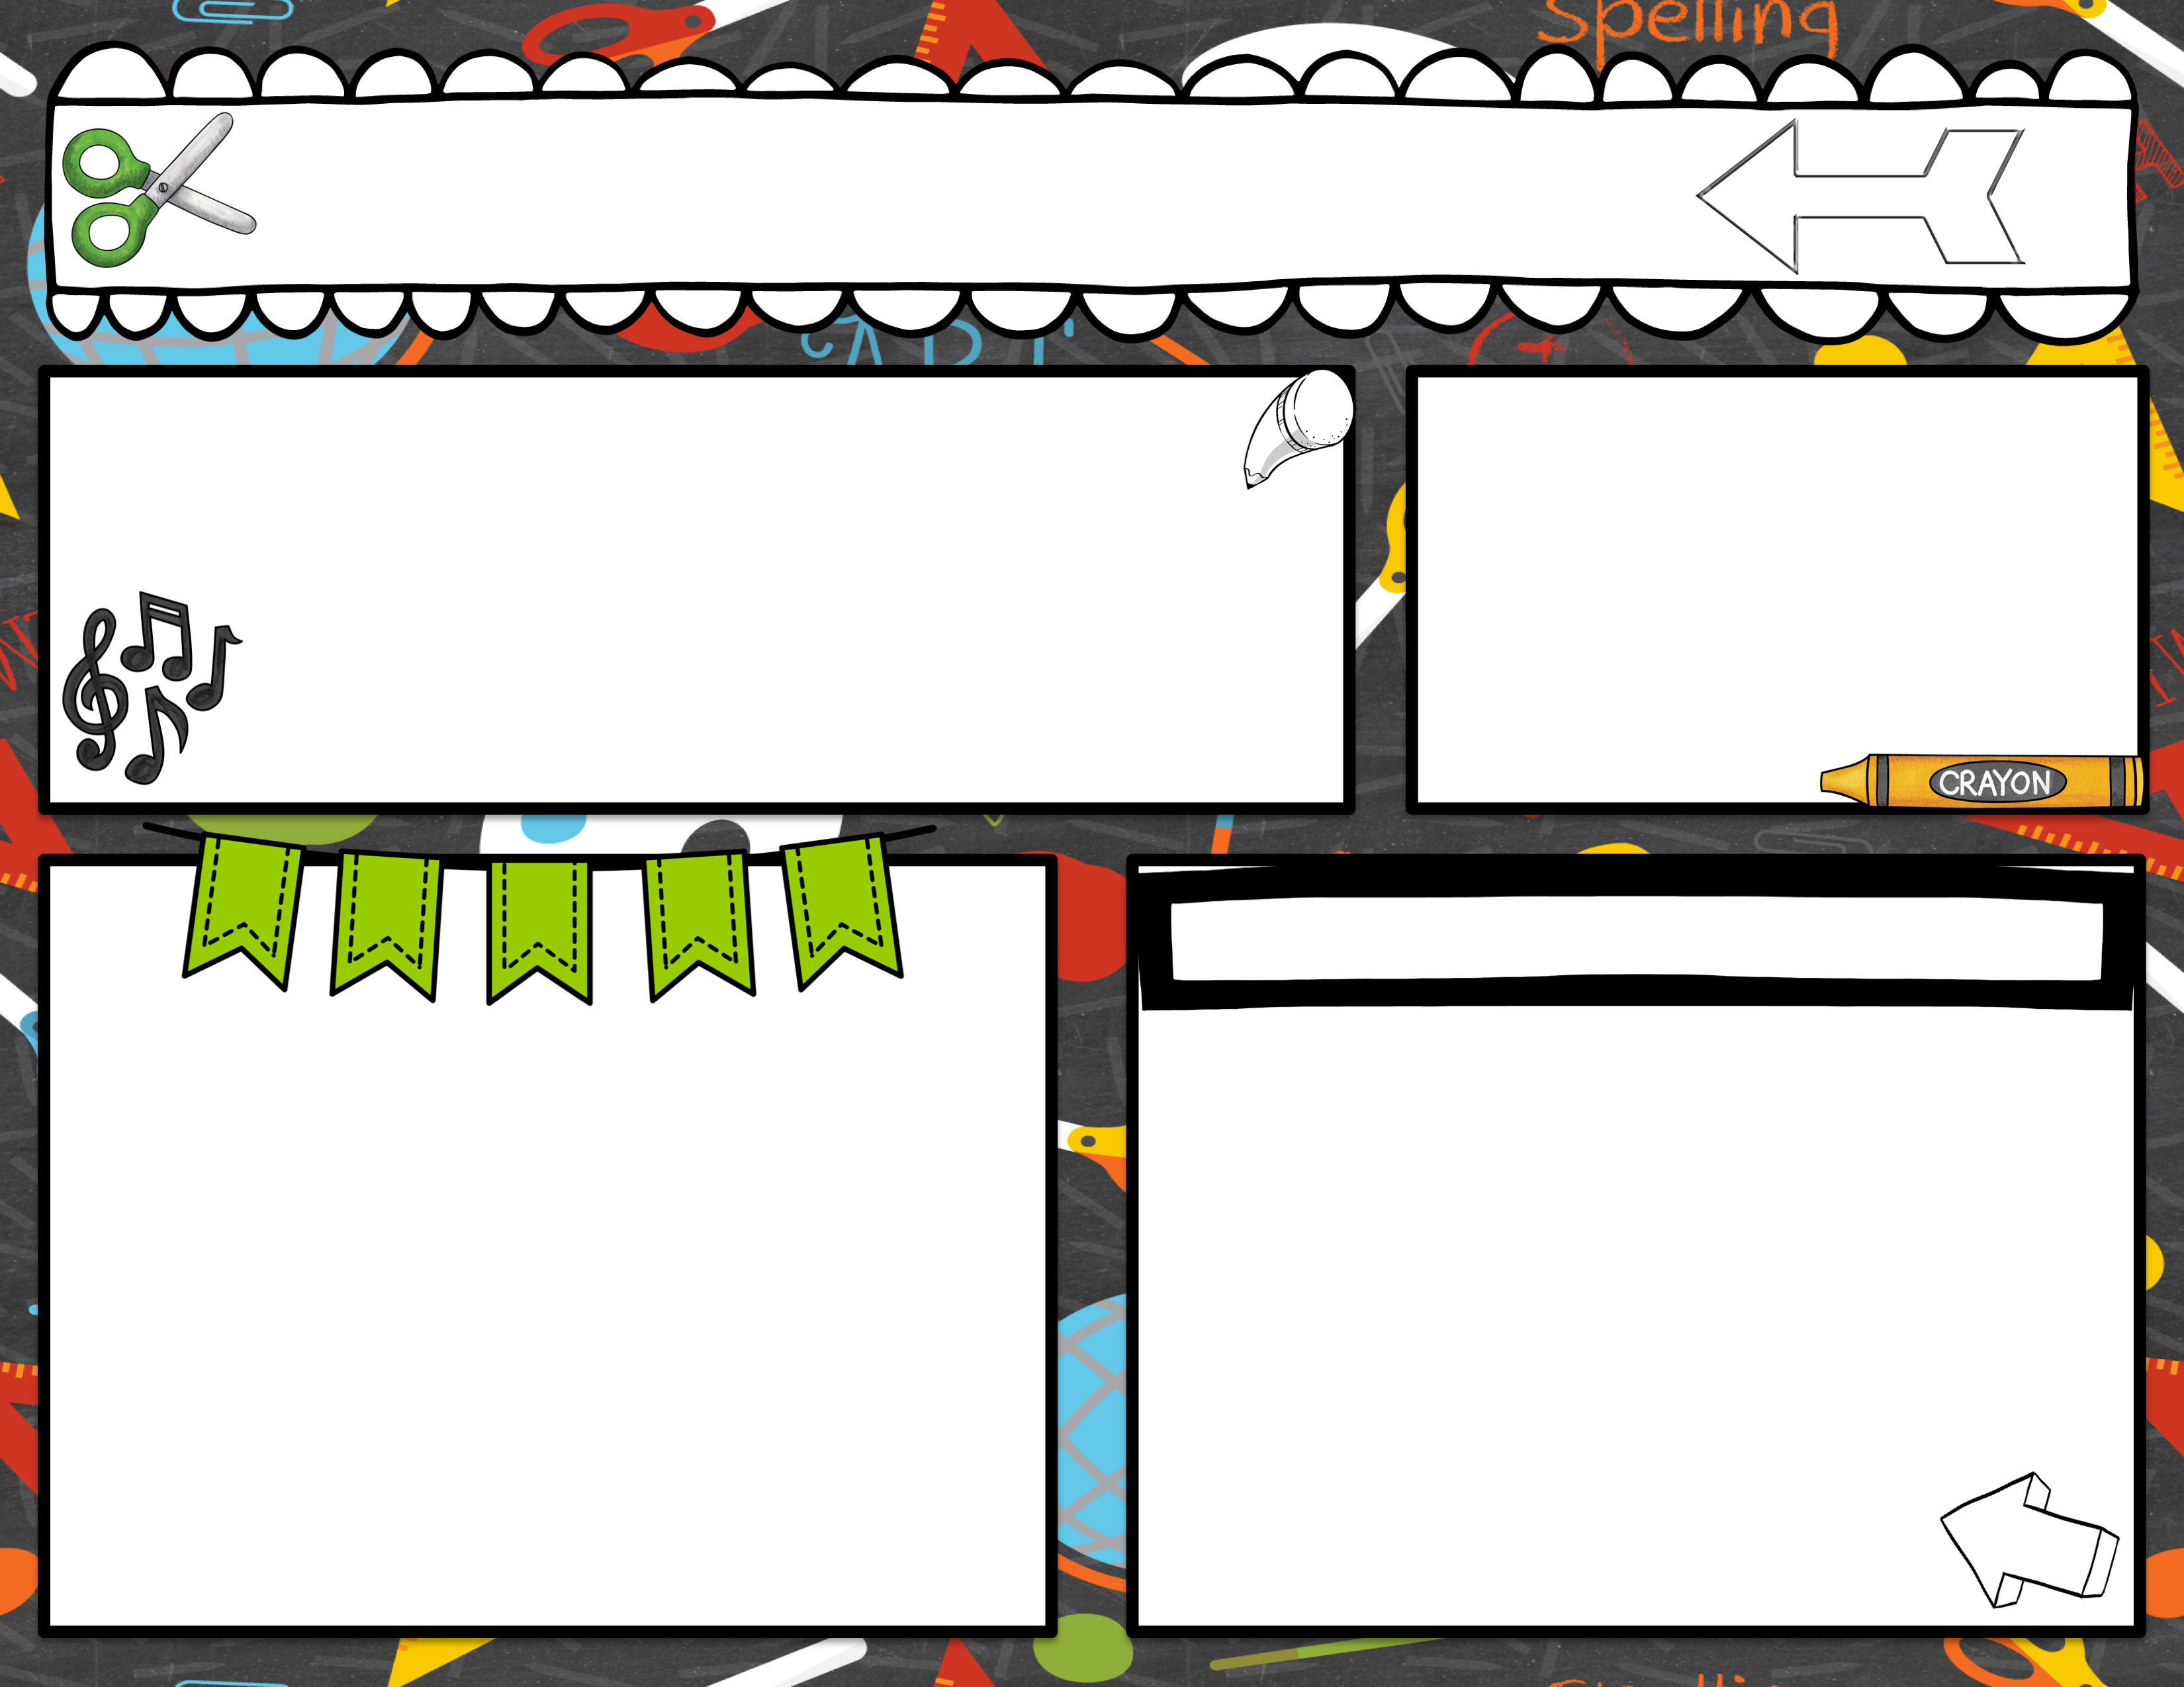
May Newsletter
End of year for 6th class
The children in 6th class have the option to finish on Friday June 16th. They are of course more than welcome to continue until June 21st.
Swimming & Yoga
Swimming will continue on a Thursday and we will have Yoga for the next four Fridays in the Hay Hall.
MEDICAL INFORMATION
Important Dates for your diary
May 23rd – Mrs Horan’s room to Glenveagh Castle
June 5th- School closed – Bank holiday
June 8th - 4th & 5th class to school tour to Arena 7
June 13th – Junior & Infants school tour to Lurgybrack
June 15th – 6th class school tour to Gartan
June 16th – End of year mass
June 21st – School closing for Summer holidays.
Please keep us up to date on your child’s medical issues.
If you’re child requires an inhaler, they must bring it with them to school.

Slide 3
May Newsletter
Cycle training
6th class will be doing Cycle training with Cycle Right over the next 4 weeks.
If you need to speak to your child’s teacher at any time contact the school office to arrange a meeting or phone call.
School lunches
ABSENCES
If your child is absent for any reason, please complete the absence from found on our app/website.
Under the Education Act 2000 the school is
Obliged to report any child that has missed 20 days or more to the Education Welfare Officer.
.
School lunches- If you are sending lunch with your child to school please ensure they are healthy lunches, no crisps or treats are permitted. A small treat may be brought in on a Friday. Please remember we are a nut free school and have children in school with severe nut allergies.

