Slide 1
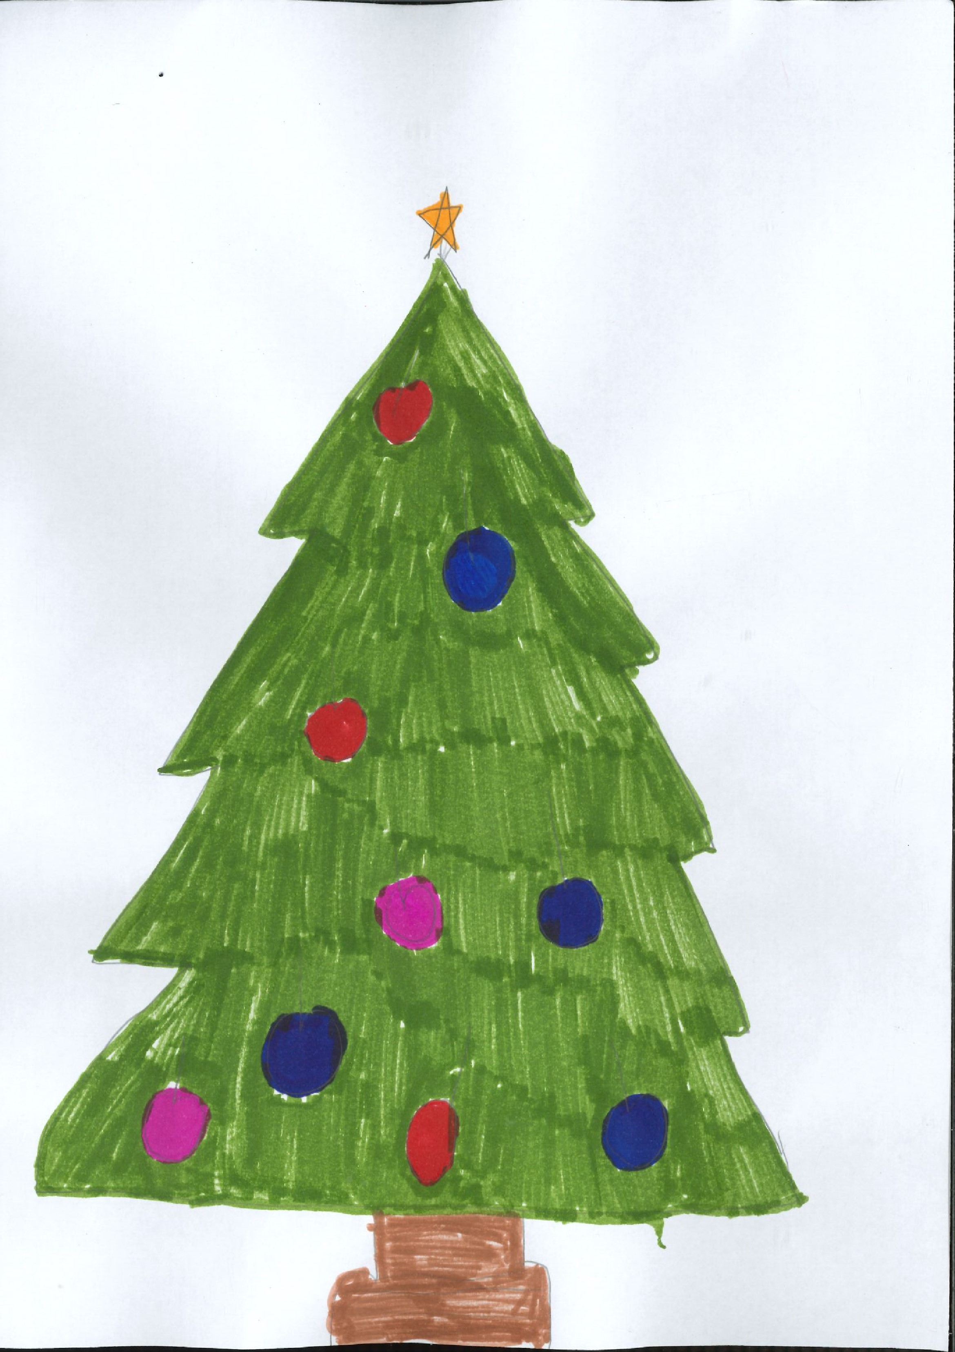
Scoil Eoin Baiste
Christmas Times
December 2022

Slide 2
The Scoil Eoin Baiste Christmas Times was created by pupils from 1st – 6th class in Scoil Eoin Baiste.
Our amazing editors were Chloe, Suzanne, Aedín, Alannah, Aimee, Tara, Bridget and Amy H from 6th class.
We hope you enjoy & Merry Christmas to all our readers.

Slide 3
A Snowy Christmas Night
By Kiera 2nd class
It was a snowy Christmas night. All the children were sleeping, when suddenly one kid heard jingle bells. She woke up and went downstairs. She looked outside and she saw Santa’s sleigh. Santa was delivering presents, when, all of a sudden a bird flew right past Santa’s sleigh and all the reindeers fell to the ground. So did Santa’s sleigh and sack. “Christmas is ruined” said Santa.

Slide 4
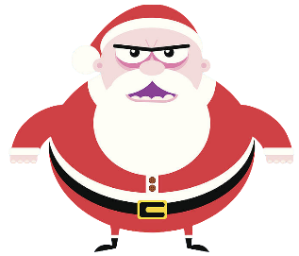
Evil Santa
Once upon a time Santa was getting ready for Christmas. He was checking on the elves but then he noticed the elves were missing. All of the presents were unwrapped and there were footprints in the snow. Santa followed the footprints and then he found his elves. They were locked up! He found the person behind it all, it was evil Santa .Santa pulled out his candy cane gun and shot evil Santa and then dropped him in a pit of lava. That’s the story of Santa saving Christmas. The End
By Sarah, 3rd Class

Slide 5
In the North Pole
Once upon a time, in the North Pole, Santa and all his elves were making toys in the factory. One day Santa got all the toys and put them in his sack. He then got his sleigh and his reindeers. He got Rudolph, Dasher, Comet, Vixen, Prancer, Cupid, Dancer and Blitzen. Then he took off in the night sky to all the houses to give children presents. When he got to the first house, he gave the boy a football, goalkeeper gloves, goalkeeper nets and surprises in his stocking. Then he went to the last house and gave the girl a doll and a unicorn teddy. He went back to the North Pole and got to eat cookies and drink whiskey. Then he went to get pyjamas and he went to sleep.

Slide 6
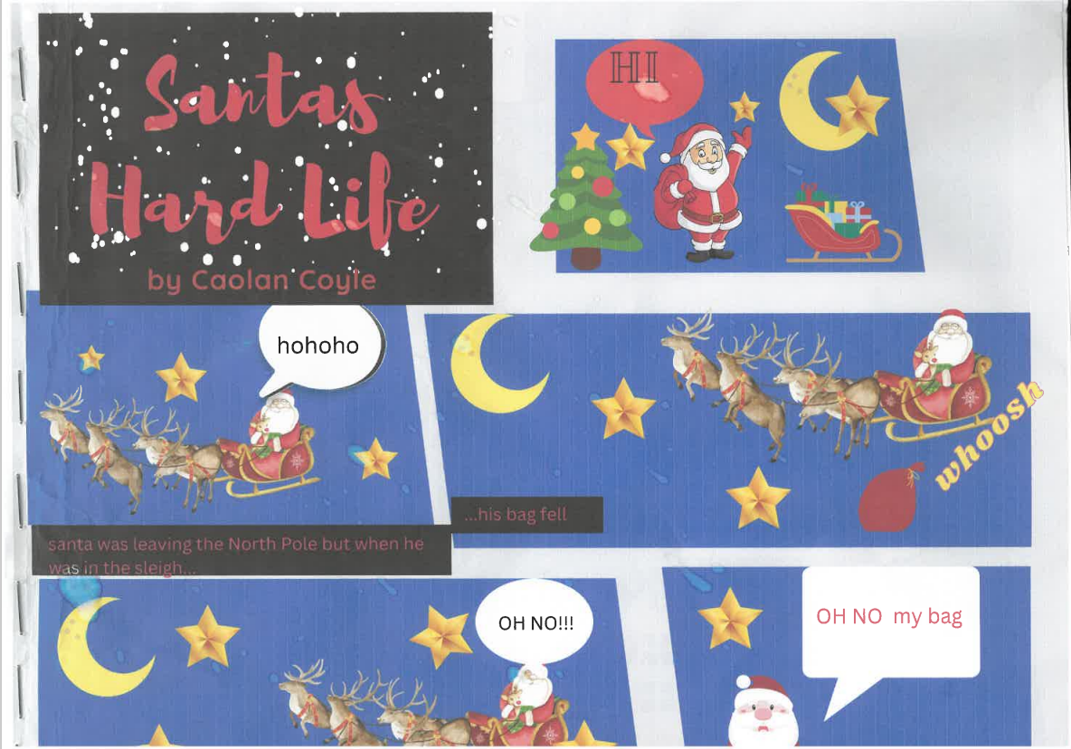

Slide 7
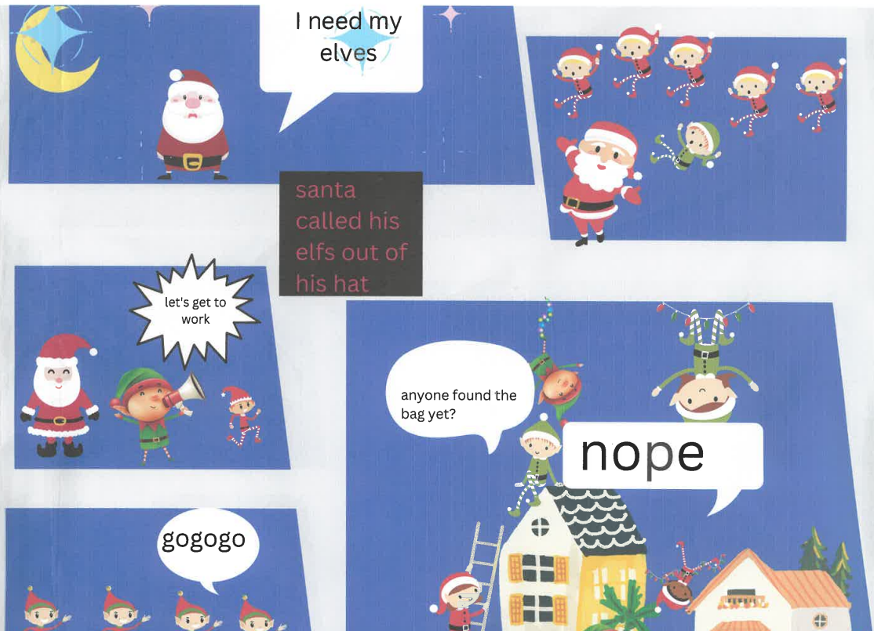

Slide 9
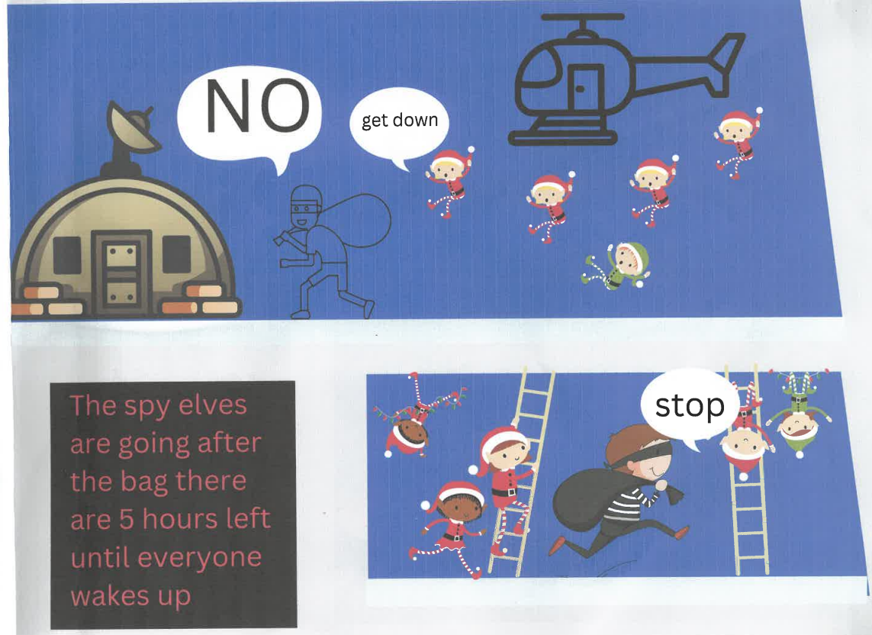

Slide 10
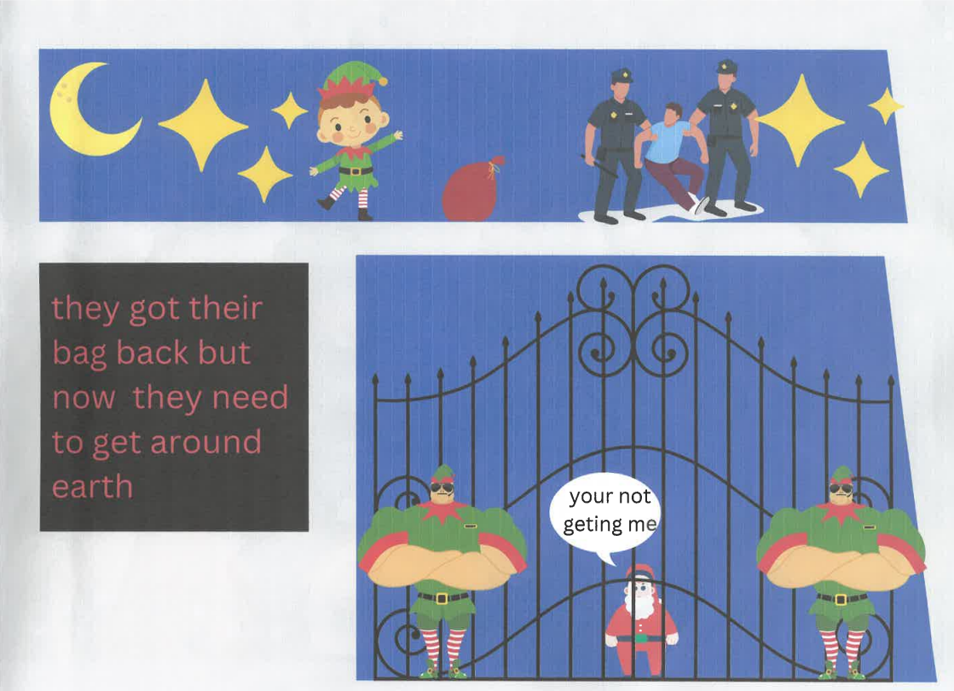

Slide 11
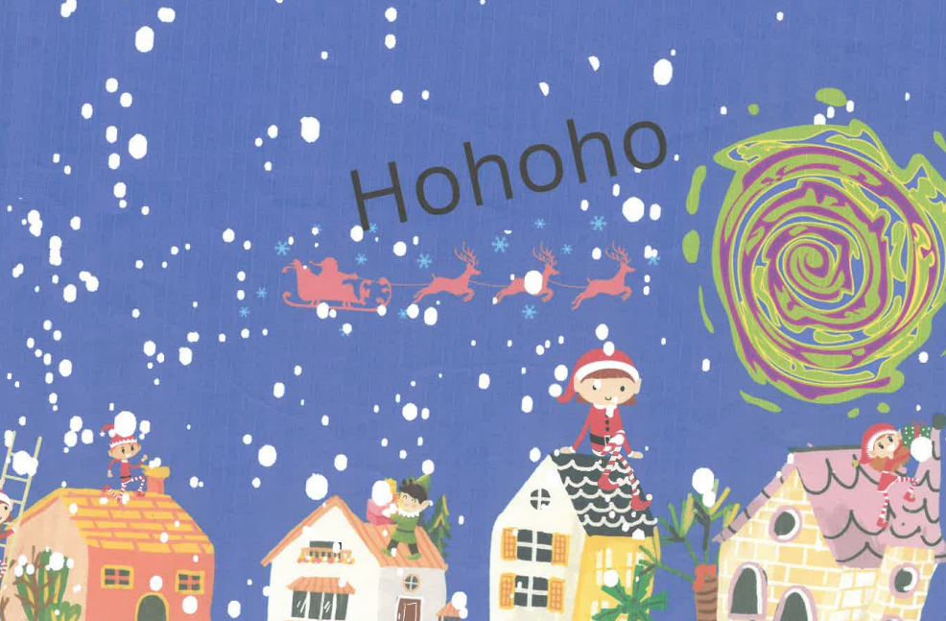

Slide 12
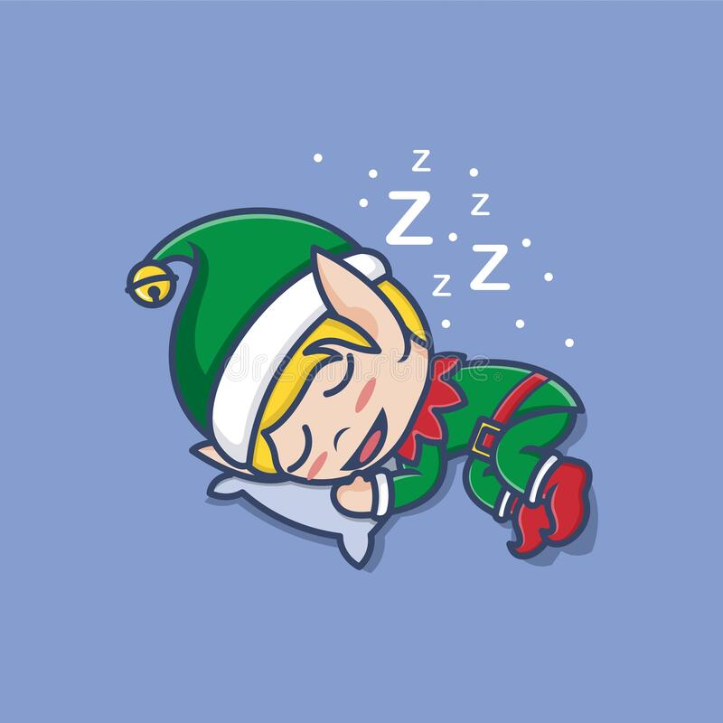
The Gannon’s Save Christmas
Suzanne Doherty 6th Class

Slide 13
Once upon a time, there was a family from Donegal. This family loved Christmas, it was their favourite time of the year. The family members were Peggy, Joe, Mary, Sinead and Sean.
Peggy was Joe's mother and Sinead and Sean's grandmother or as they called her Grams. Peggy was well known for her delicious homemade custard pie that she would make every year for Christmas.
Joe was Peggy's son. He loved Christmas, it was the one time of year he was able to make his famous stuffing. His stuffing was homemade and really delicious. He was also really good at making Christmas sleighs for Sinead and Sean.
Mary was Joe's wife. They both met at a Christmas party in their village. Mary loved cooking, she especially loved cooking the Christmas dinner. She worked in a gift shop, wrapping the gifts. That is why she was so good at wrapping Christmas gifts, people would often compliment her.
Sinead and Sean were twins. They both loved Christmas so much! Sinead loved reading and Sean loved building aeroplanes out of wood. Sinead wanted to become an author and Sean wanted to become a pilot.

Slide 14
Once upon a Christmas Eve. Snowflakes were falling from the sky like crystals. The radio was playing the Gannon's favourite jolly Christmas songs, the fire was dancing through the logs and Sinead and Sean were watching their favourite Christmas movie.
Suddenly all the TV stations turned to the news.
"BREAKING NEWS", Sean read from the TV. “Santa is not prepared for Christmas Eve and... Christmas might be cancelled for this year!”, stated the news reporter. “The reindeers don't have enough energy, Mrs Claus has forgotten to wrap the presents, the elves are in a deep sleep and won't wake up and the sleigh doesn't have its powers to fly up to the sky!"
"Oh no!" said the family devastated. Sinead and Sean thought to themselves that there had to be a way they can help. lt took a lot of convincing for Joe and Mary to agree to go and help Santa. They thought about how they could help.

Slide 15
Peggy thought everyone could say a way that they would like to help. Sean went first, “Sometimes when I'm in my aeroplane and I wish and wish and wish. l can imagine that the plane is flying so we could wish and wish and wish and maybe we would get to the North Pole". They all agreed.
"Well, I made a poem at school and it's called ‘Wake Up Little Elves’ and it's in Elvish, so maybe that would wake them up?”, explained Sinead. They all thought about it and thought they could give it a chance.
Peggy went next, “Since my custard pie gives you all a sugar rush maybe it would give the reindeers some energy to lead Santa." "Without a doubt that would work”, said Joe. "Maybe my days in the gift shop might come in handy since I could wrap all the gifts”, Mary boasted.
Lastly it was Joe's turn to give his suggestion, “Since I make sleighs for Sinead and Sean every year I could make one for Santa". They all agreed on that one. “Well, they were all amazing suggestions and I think we should do them all”, said Mary.

Slide 16
So Peggy mixed her ingredients in a bowl, while Sinead got her poem. Mary got all the wrapping paper she had and when the custard pie was ready they went straight to Sean's aeroplane. They all wished and wished and wished to get to the North Pole and when they opened their eyes they saw snow and the reindeers. They assumed it was the North Pole. They saw a little small brown cabin, “This must be Santa's workshop”, Sinead said excitedly. They knocked on the hard wood door. The door opened, it was Mrs Claus. She was so worried that Christmas was going to be cancelled but was glad to see some help.
Mrs Claus gave everyone their jobs. Sinead was with the elves, she read out the poem in Elvish ten times and it worked, one by one each elf woke up. Mary went over to the presents, “There must be a lot of nice children around the world because there are a lot of presents here". Eventually herself and Mrs Claus got all the presents wrapped. Peggy had cut the pie into ten pieces. One for Dasher, Dancer, Prancer, Vixen, Comet, Cupid, Donner, Blitzen, Rudolph and one slice for herself. The reindeers loved it so much that Peggy thought they were saying, "More, More, More".

Slide 17
Lastly, Joe had to give the sleigh some powers but Joe didn't have any powers! His sleigh, that he makes for Sinead and Sean, had all the powers a sleigh needs. With some wood, Joe put together a big version of what he would make for the twins.
Santa said,"Ho,ho,ho what a wonderful sleigh!". Finally they all put the presents at the back of the sleigh as well as the elves and they all screamed,"10,9,8,7,6,5,4,3,2,1!“, the sleigh took off. Everyone felt so happy.
They had a cuppa with Mrs Claus and then went back to the aeroplane and again they wished, wished and wished and when they opened their eyes they saw their home. They all went straight to bed because Santa doesn't come if you’re awake. The next morning, they woke up to some wonderful gifts and a letter from Santa saying "Thank you!”.
Later that day they had Mary's wonderful cooking along with Joe's stuffing and for dessert Peggy's custard pie. “That was one of the best Christmas’ we've had”, Peggy said so happily.
THE END

Slide 18
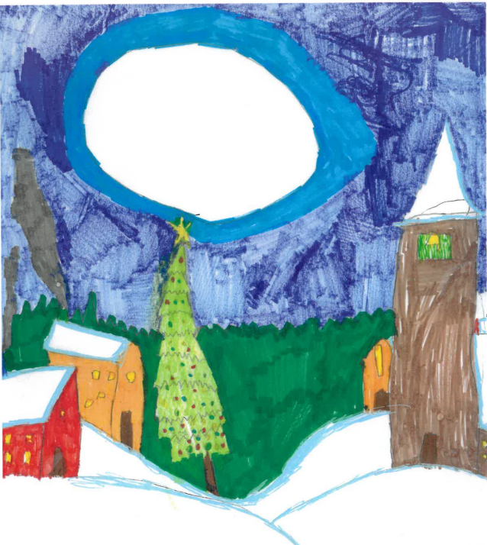
By Francesca 1st class

Slide 19
The Christmas Adventure
One family lived in Belfast, and it was very busy. There was John the Dad, Lilly the Mum, Eve the daughter and Noah the sonly was 25 days until Christmas. We are starting our countdown. That night the elves came. "l hope they don't cause any trouble this Christmas, so they did and the elves are going to cause more trouble than ever before. The elves are staying until New Years Eve.
On the first night Eve and Noah put up a camera and they saw the elves were watching TV. Eve and Noah sent their lists to Santa. On Christmas eve John and Lilly put family gifts under the tree. After that Santa came and put the presents for Eve and Noah under the tree. "It is Christmas' cheered Eve. Eve and Noah got a lot of presents. "l love Christmas!" said Noah. The elves were very sneaky. Eve saw the elves move in the middle of the night.

Slide 20
The next morning Noah dressed the elves, then he had to put cinnamon on the elves because he touched them, it was Lilly's birthday after Christmas. The elves wrote on Lilly's face and it said ‘Happy birthday Lilly from the Elves'. They made snowmen on her birthday. Noah and Eve were playing in the snow and the elves were secretly playing in the snow too. "That countdown went fast" said Noah. Then Lilly made them hot chocolate, "YUMMY" said Eve. "The elves said bye " said
Noah and Eve. Eve and Noah were sad that the elves left, even though they were extremely naughty. When the elves flew back they met Santa in the workshop and Santa said, "Were you EXTREMELY naughty! "Noah and Eve said to Lilly "l miss Christmas, it was just the best. Then Lilly said, "Help me take down the Christmas decorations“. Noah and Eve missed Christmas too much Lilly let them watch the Grinch. Noah got lifted up by dad and Eve got lifted up by mum. Eve and Noah took down the star, Eve took one side and Noah took the other. Lilly and John said "Christmas is over“. Noah and Eve felt like this Christmas was an adventure. At midnight we watched and we watched the countdown and they alt said," 10,9,8,7,6,5,4,3,2,1 !lt's 2023!"A few days later Noah knocked on Eve's door and said "Can you play with me? Do you know what I am thinking because I miss
CHRISTMAS!“. When Noah was saying he misses Christmas he was shouting, he fell flat on the ground.

Slide 21
Jolly Holly Village
By Olivia Doherty
Donegal, lreland is always very festive around this time of year but there is one house that goes out of their way to really make it feel like Christmas and that is the Mc Clauses house. Sonia, the mum, always makes hot chocolate for the children playing outside on a cold misty afternoon. Michael, the dad, loves building sleighs for the children around the town. Orla and Ódhran are the children in the family and love making snowmen, snow angels and even sometimes try to find a path to The North Pole.
Ódhran and Orla were setting up a Santa Security camera they found at the local shop when Sonia was buying the last of the limited edition raspberry sweet savoury cookies for her special cookie crumble she makes every year, when Michael called both of them upstairs to tell them the exciting news that their cousin Seamus would be staying with them this Christmas, along with his mum Ciara and his dad John. Ódhran and Orla didn't really like Seamus because he always pretends he is a spy and would spy on them all day!

Slide 22
Soon after they found out that Seamus and his family would be staying, they heard a thud at the door. Sonia thought that it was her new Christmas Tipperary crystal mugs she had been waiting on for ages. Michael thought is was his new wood to make more sleighs with and Ódhran and Orla knew it had to be their cousin Seamus and his parents and it was. As soon as he arrived, Seamus stormed off to the guest bedroom where he would be staying for the next few nights.
The next morning Ódhran, Orla and Seamus were playing outside making snowmen and snow angles when Seamus pointed out that there was a very bright light coming from the old abandoned alley. “Let’s go check it out!”, shouted Ódhran. “Are you sure that's a good idea?” asked Orla. “Oh come on Orla!” exclaimed Seamus. “FlNE! I will go if you really want me too” replied Orla.
A few minutes passed and they arrived at the alley. All they could see was a bright portal. Seamus and Ódhran jumped into the portal with no hesitation but Orla could not make up her mind if she wanted to or not. Somehow Seamus convinced her that it was a good idea. Next thing they knew they were in a festive little village with Candy Canes as trees, Gingerbread grottos as houses and Elves as people.
Soon after they found out that Seamus and his family ».ould staying they heard a thud at the door,Sonia thought it was her new

Slide 23
Soon after, an elf came up and introduced herself to them. Her name was Cindy and she was Top Elf here at “Jolly Holly Village". Cindy gave the children a tour of the village and right before they were going to go into the Elf Headquarters, all of them heard a siren. A siren that only goes off, when somebody had stolen The Special Christmas Diamond that shows ‘Jolly Holly Village’ on Santa’s map.
“OH NO!!”, cried Cindy. “What does that siren mean Orla?”. “lt means that somebody has the Christmas Diamond that makes Jolly Holly Village visible on Santa's map”, replied Cindy. “So, does that mean that all of the little girls and boys in Jolly Holly Village won't get any presents from Santa this year?” asked Ódhran. “For now sadly, yes” cried Cindy. “Surely there is a way to fix this”, stated Seamus. “Only if we can catch the person who did this and if we were to do that we would have to go to challenge No.1”, said Cindy.

Slide 24
Challenge No.1 was to count all of the bells in the Candy Cane Forest. The four of them entered the forest and quickly started looking for all of the bells. “Got one!”, shouted Orla. “Maybe we should split up”, suggested Ódhran. “Yeah I think we should!!”, replied Seamus. After that they all split up and they found the bells faster. “l think we are done”, said Cindy. Right after Cindy said that, a strange voice started speaking, “Hello fellow friends, I have the Christmas Diamond and the only way you can get it back is to complete all of the challenges I have assigned for you all and by the end, if you have finished them, you will be given the Christmas Diamond. l see you have finished the first challenge so you better move on to the second one.”
Challenge No.2 was to try and colour coordinate all of the presents. There was a note left beside the bundle of presents and on it said, "These presents are wrapped in white wrapping paper and each of them has a special ribbon tied on to them. All you have to do is make a pile for each colour on the ribbons. The four of them heard a bell noise and that meant that their time had begun. "The note didn't say anything about a time limit“ exclaimed Seamus. "Seamus come on we need to start" shouted Orla.

Slide 25
They all started and were going very fast by the looks of things but then they found out that they were making different piles for themselves so there was four piles of every colour then they all had to combine them and right when Ódhran dropped the last present the bell rang again. "YAY!! We are done“ they all cheered. The strange voice appeared again and said ‘Congratulations it looks like you have finished the second challenge but to get the Christmas Diamond you will have to finished the third one, Good Luck’.
Challenge No.3 was to try and find all of the puzzle pieces for the puzzle. They all arrived at a
strange looking grotto and on the door said " You all have to complete this challenge by finding all of the puzzle pieces, if you happen to find all of the puzzle pieces and build the puzzle it will show you a map of where I have hidden the Christmas Diamond". They decided that Seamus and Cindy would stay back and wait for the puzzle pieces while Ódhran and Orla would look for them. The bell noise rang again and they all knew that their time had begun. Ódhran and Orla started looking in the snow and found some there. Orla stayed back looking for pieces while Ódhran gave them to Seamus and Cindy. A few minutes pass and all they need is one more piece. "l have looked everywhere I have no idea where this piece could be" said Orla. 'Well we haven't looked in that Iittle igloo have we, I think we should?" suggested Ódhran. “Where is this puzzle piece?” shouted Ódhran. “I got it” cheered Cindy.

Slide 26
The bell rang again, “Hurry up we still have to make the puzzle” exclaimed Seamus. They finished the puzzle and on it hap a map of where Christmas Diamond was.
A few minutes pass and they find themselves in front of a cave. “Are you sure we are in the right place?” whispered Orla. They all tiptoed into the cave and Seamus saw a sign that read ‘Be Careful’. “Look at that sign, are you sure we should be here?” asked Seamus. “I think whoever stole the Christmas diamond is just trying to scare us off” said Ódhran. “yeah I think you are right” replied Cindy. They all heard footsteps coming towards them and then heard a little voice saying “Hello my name is Elvis and I have your Christmas Diamond. They all walked up to collect the diamond and Cindy asked “why did you steal the Christmas Diamond?”. I..I.. Just wanted someone to know I exist” muttered Elvis. “Oh well I knew you existed and everybody back at home did but they are still wondering why you left to go here”. “ Well I do miss them all a lot but I love my job here”.
Soon they all began their journey home, they arrived not long after and Cindy placed the diamond back into its original case. “Goodbye Cindy and Elvis” the children cheered. “Don’t forget this is our little secret” whispered Cindy and Elvis. THE END

Slide 27
Christmas in Ukraine
In Ukrainian Happy/Merry Christmas is 'Веселого Різдва' Veseloho Rizdva (Merry Christmas) or 'Христос Рождається' Khrystos Rozhdayetsia.
The main Christmas meal, called 'Sviata Vecheria' (or Holy Supper) is eaten on Christmas Eve (6th January). Traditionally people fast (don't eat anything) all day but you might start the day drinking some holy water that has been blessed at church.
You can't start eating the meal until the first star is seen in the sky. So people (especially the hungry ones!) go outside as soon as it start getting dark in the afternoon to try and spot the first star. The star represents the journey of the Wise Men to find Jesus and that Jesus has been born, so Christmas can start!

Slide 28
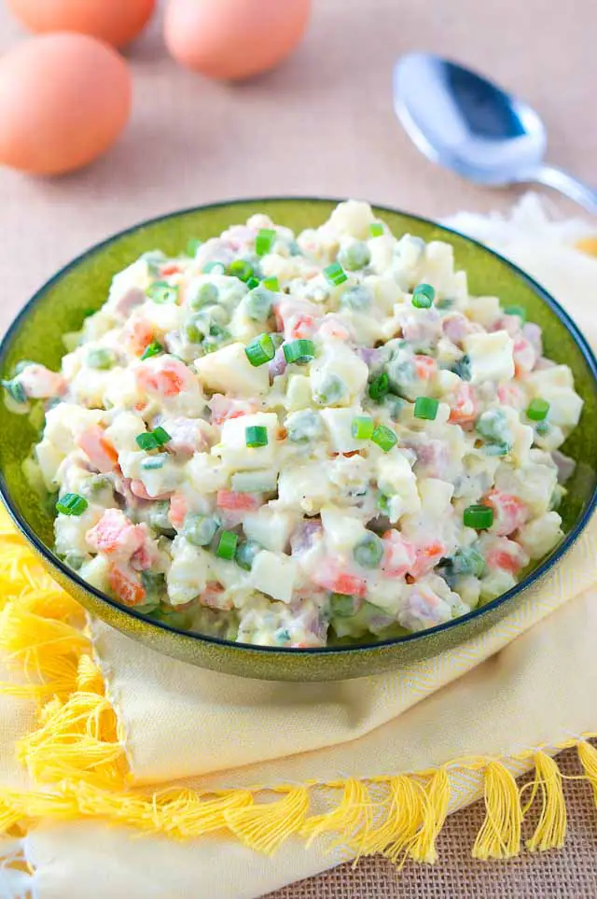
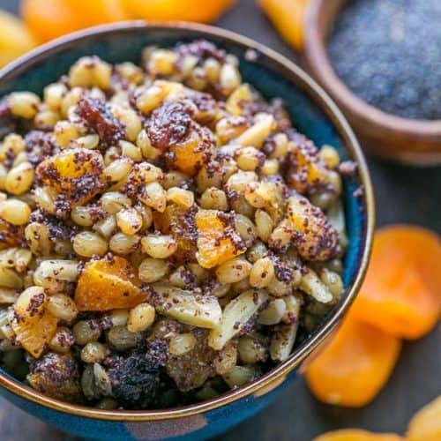
Different dishes are prepared before Christmas, and one of them must be prepared every Christmas. This dish is salad ‘’olivie’’. It is a salad with potatoes and boiled sausage- ‘’I have not seen it in Ireland!’
Some of the Food we eat at Christmas
Kutia or Kutya is a Ukrainian sweet grain pudding that is traditionally served as part of a twelve-meal Christmas Eve supper.
These are the juices we love to drink.

Slide 29
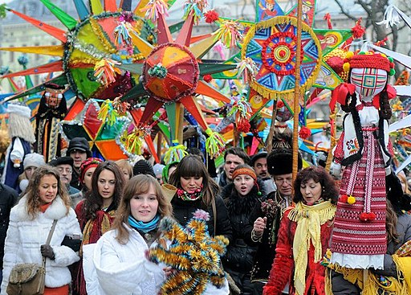
After the meal, people love to sing carols or 'Koliadky'. They can be sung around the table or you might go out caroling in the streets. People sometimes carry brightly colored stars on poles when they go caroling singing.
The Ukrainian carol 'Shchedryk' is where the popular 'Carol of the Bells' came from.

Slide 30
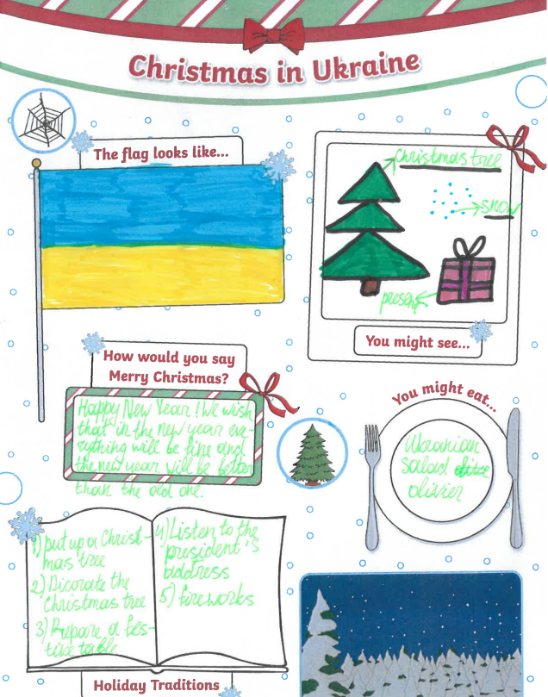

Slide 31
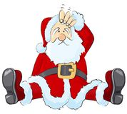
Did you Know?

Slide 32
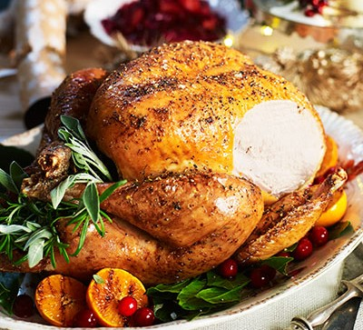
When did we start eating turkey for Christmas?
The turkey appeared on Christmas tables in the 16th century. The 16th century farmer Tomas Tusser noted that by 1573 turkeys were commonly served at English Christmas dinners.
By Evie 3rd class

Slide 33
What countries do not celebrate Christmas?
By Lily 5th class
Afghanistan, Algeria, Bhutan, north Korea, Libya, Mauritius, Sahrawi, Arab democratic republic, Saudi Arabia, Somalia, Tajikistan, Tunisia, Turkmenistan, Uzbekistan, and Yemen do not celebrate Christmas.

Slide 34
Why do we give presents at Christmas
We often give gifts to re-confirm or establish our connection with others. Giving a gift to someone we care about allows us to communicate our feelings of appreciation for them.

Slide 35
Jokes Section
By Rionach and Lilly
What happens to elves when they behave naughty? Santa gives them the sack.
What did one Christmas tree say to another? Lighten Up!
Knock, Knock! Who’s there? Donut? Donut who Donut open this present until Christmas!
What do Snowmen eat for lunch? Iceburgers!
What is a Christmas tree’s favorite candy? Ornaments!
Why is it so cold at Christmas time? Because it’s in Decemberrrrrrrrrr.
Why did the boy throw the clock out of the window? He wanted to know when Christmas was coming.
How do you say oh oh oh going backwards? ho ho ho
What did the reindeer say when he lost his magic? Oh deer
Why did the elf cross the road? He wanted to learn the elf-abet.

Slide 36
Alannah’s Jokes Section
What is Santa’s dog’s name?
Santa Paws
What do Santa’s elves learn in school?
The elf-abet
What do Snowmen eat for breakfast?
Ice-Crispies
How much did Santa pay for his Sleigh?
Nothing, it was on the house

Slide 37
Where would you find a Snowman dancing?
At a Snowball
What athlete is warmest in winter?
A Long Jumper
What’s every Elf’s favourite type of music?
Wrap
What would you give a dog for Christmas?
A Mobile Bone

Slide 38
Kacey’s Joke Section
What do Santa’s elves drive? Minivans
What is a Christmas trees favourite candy? Orna-mints
What do Snowmen eat for Breakfast? Snow Flakes
What do you call Santa when he stops moving? Santa Pause
Why was the little boy so cold on Christmas morning? It was Decemberrrrrrr

Slide 39
Poems Section

Slide 40
What a wonderful CHRISTMAS NIGHT!!!
It was a cold snowy Christmas Eve night,
The little children were in bed tucked in tight,
Santa was on his way,
In nis big red sleigh!
“On Dasher, On Dancer, On Prancer, On Vixen,
On Comet, On Cupid, On Donner and Blitzen”
Santa landed on the roof with a bang,
“HO HO HO!!! MERRY CHRISTMAS!!” He sang!!
Santa slid down the chimney,
But woke a child named Whinnie,
Whinnie came to have a peek,
It’s Father Christmas EAAKKKKKK!!!!!!!!!!!!!!!!!!!!!!!!!!!!!!!
Shhhh!! Little girl don’t make a noise,
Otherwise you’ll wake up the boys,
Goodnight little Whinnie,
And remember don’t be silly!

Slide 41
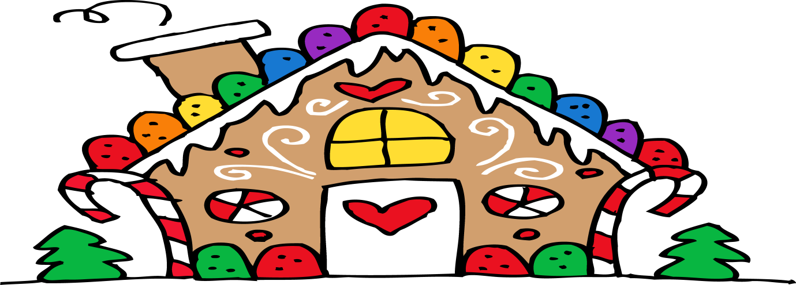
Mia 4th Class
My Gingerbread House
I made a house of gingerbread
It was so sugary sweet,
It took me all day to make,
But it lasted just a week.
On Monday I ate the ceiling
On Tuesday I ate the floor,
On Wednesday I ate the windows,
On Thursday I ate all four walls
On Friday I ate the lawn,
On Saturday I licked up all the crumbs
My Gingerbread House Was Gone!!!!!!!!!

Slide 42
Merry Christmas
May the love of christmas
Play true for you ,
A time to be happy in all that you do
The holiday season
Is marshmallow fun
Smiley faces are in everyone
On this christmas day
Let it fill you with laughter
Bring you festive joy
And a happy ever after
By Chloe Mc Gettigan 4th Class

Slide 43
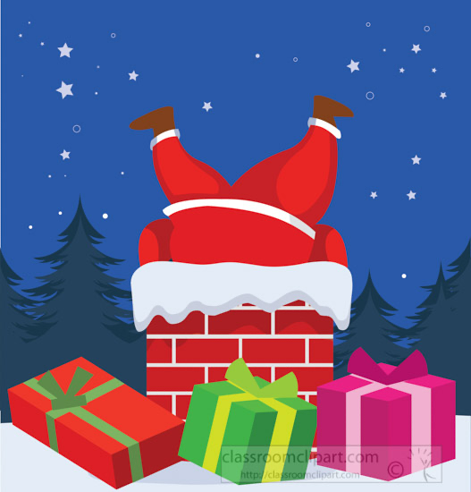
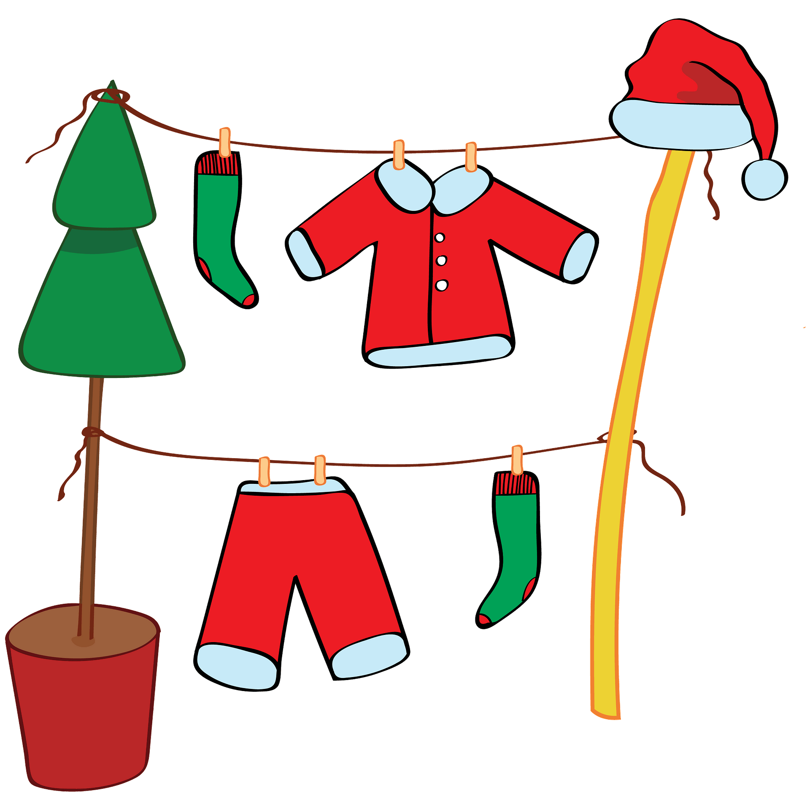
My Lucky Christmas
I was down the road
Next thing what did I see?
A big red hat
Oh, I wonder who it could be?
The closer i got
I couldn't believe my eyes
For it was only santa claus
He was stuck in the snow
With only one boot on his toe
I tried to push him out
With a big heave ho!
The reindeer ran away
There was only one wheel on the sleigh
The elves came to help me
Oh thank God hip hip hip hooray!
Finally Santa got free
He said a jolly thank you to me
I had the best Christmas ever
With my friends and family
PS: I might get an extra present or two!
By Oisin Gallagher
My Lucky Christmas By Oisin 3rd class
I was down the road
Next thing what did I see?
A big red hat
Oh, I wonder who it could be?
The closer I got
I couldn't believe my eyes
For it was only Santa Claus
He was stuck in the snow
With only one boot on his toe
I tried to push him out
With a big heave ho!
The reindeer ran away
There was only one wheel on the sleigh
The elves came to help me
Oh thank God hip hip hip hooray!
Finally Santa got free
He said a jolly thank you to me
I had the best Christmas ever
With my friends and family
PS: I might get an extra present or two!

Slide 44
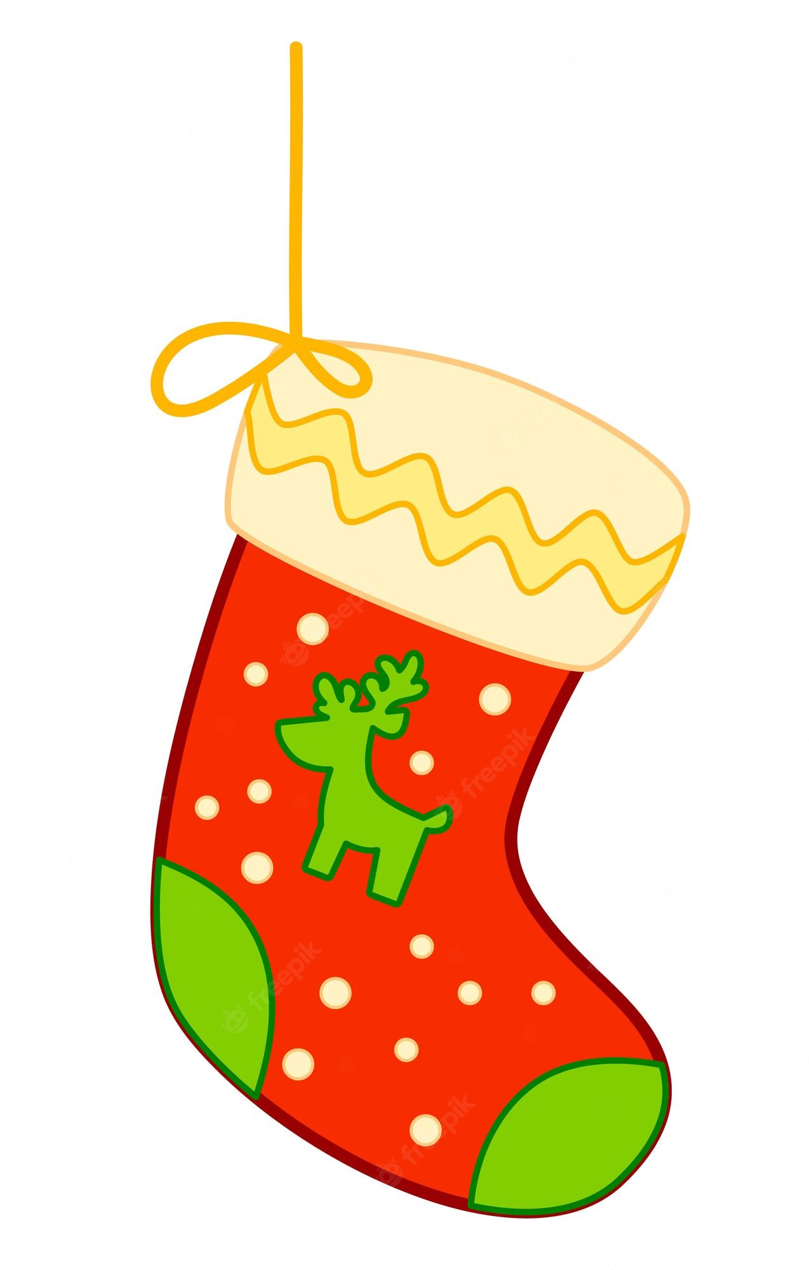
Christmas Acrostic Poem By Claire O’ Doherty
Hurrying to get to bed,
Reading “t’was the night before Christmas”,
Icicles falling on the window ledge,
Stockings hanging on the fireplace,
Tasty bites ready for Santa,
Mince pies on the tray,
And the streets in a white blanket of snow,
Santa Claus is on his way!

Slide 45
Christmas Eve by Molly, 1st class
On Christmas Eve, I am always so happy.
It is so much fun.
The Christmas tree is up.
Mum, dad, Lewis and I all put up the Christmas tree
The lights are twinkling on the tree
I am waiting hard for Santa to come.
I leave cookies and milk and carrots for Rudolph,
Santa is the best.

Slide 46
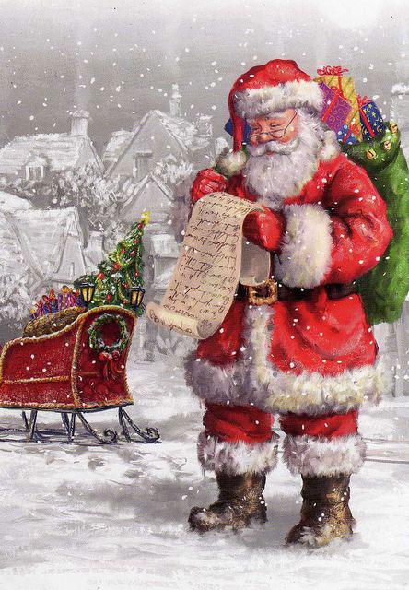
S-A-N-T-A
Who laughs this way!
HO-HO-HO
S-A-N-T-A
Who drives his sleigh
Through the snow!
S-A-N-T-A
His hair is white.
His nose is red.
He wears a hat
Over his head.
Who brings fun for girls and boys?
S-A-N-T-A
By ELLIE WILKIN

Slide 47
Things At Christmas
Snowflakes falling from the sky
is so nice and we get to play in the snow.
It is great when you get to do Christmas shopping.
Something that is great about Christmas is the elves.
They make lots of trouble
and waiting on Christmas Eve is so exciting.
Christmas is the best!
By Francesca

Slide 48
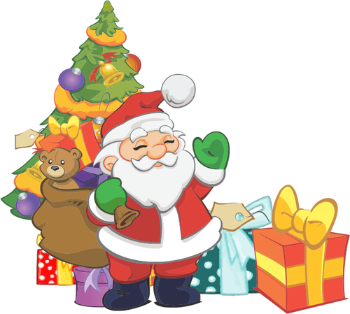
A Christmas Poem
Every child is excited this year
For Christmas when we all cheer
Look Santa ate all the cookies
He also drank the milk!
He’s left presents
For every boy and girl
Let’s open the presents
so we can play games.
Turkey, spuds, gravy if you wish
Ice cream and jelly what an amazing dish
Thank Santa for a great day
Let’s all shout HOORAY!
By Erin Coyle

Slide 49
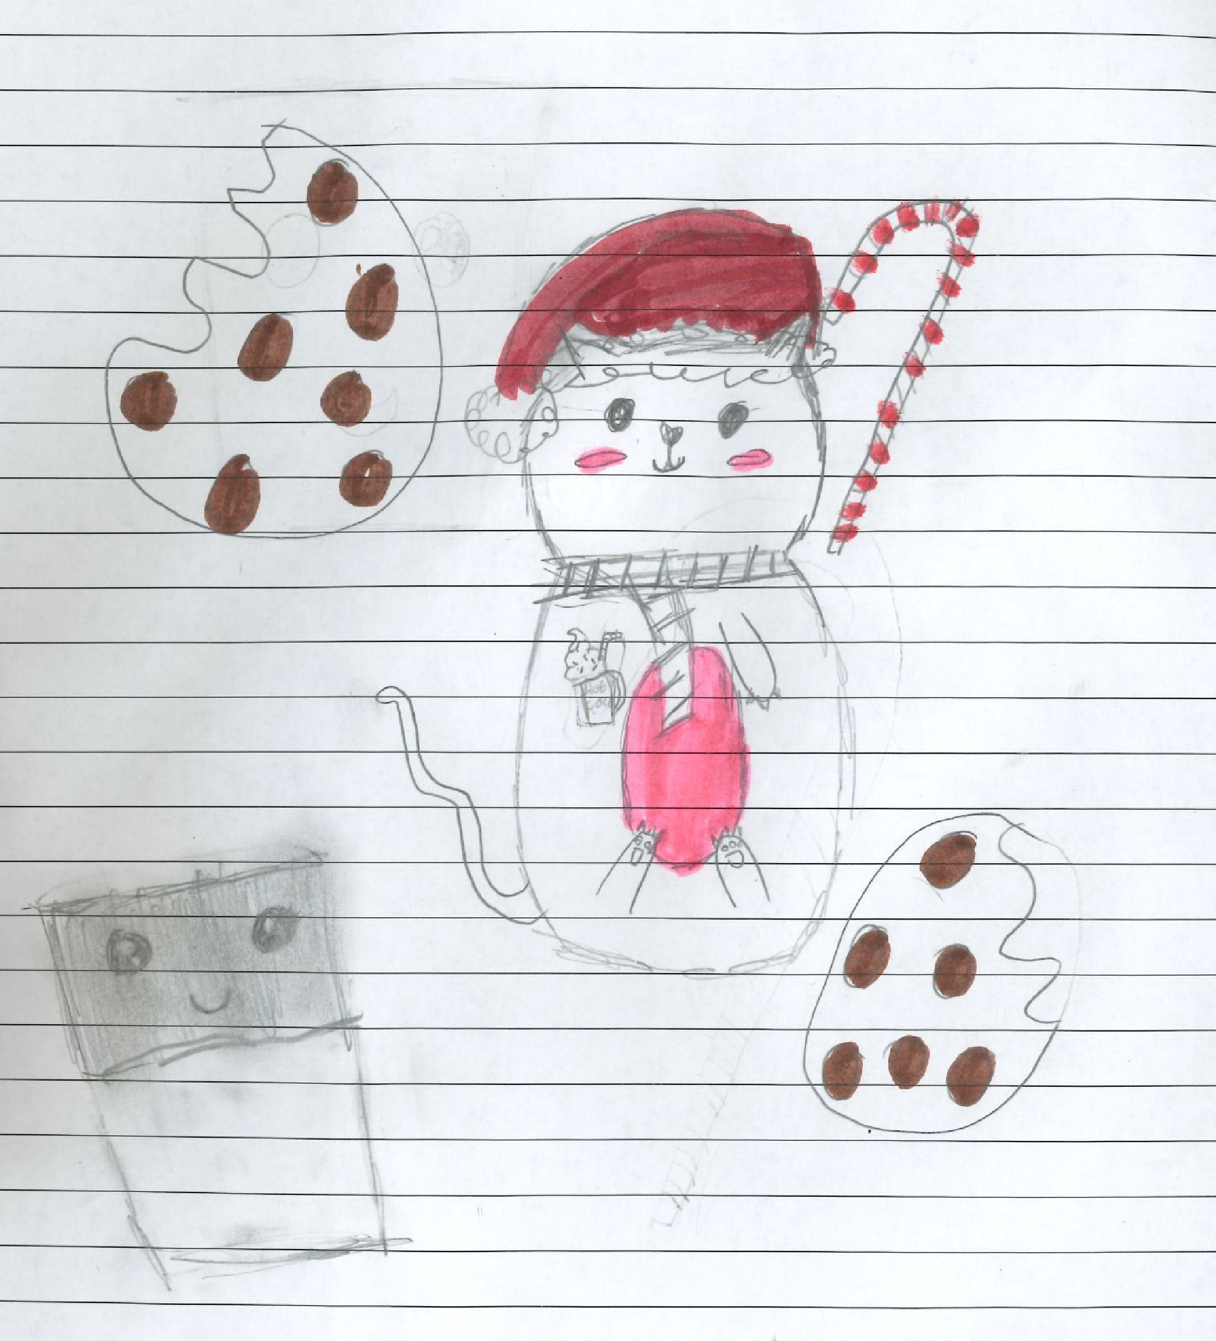
Ciara 4th Class

Slide 50
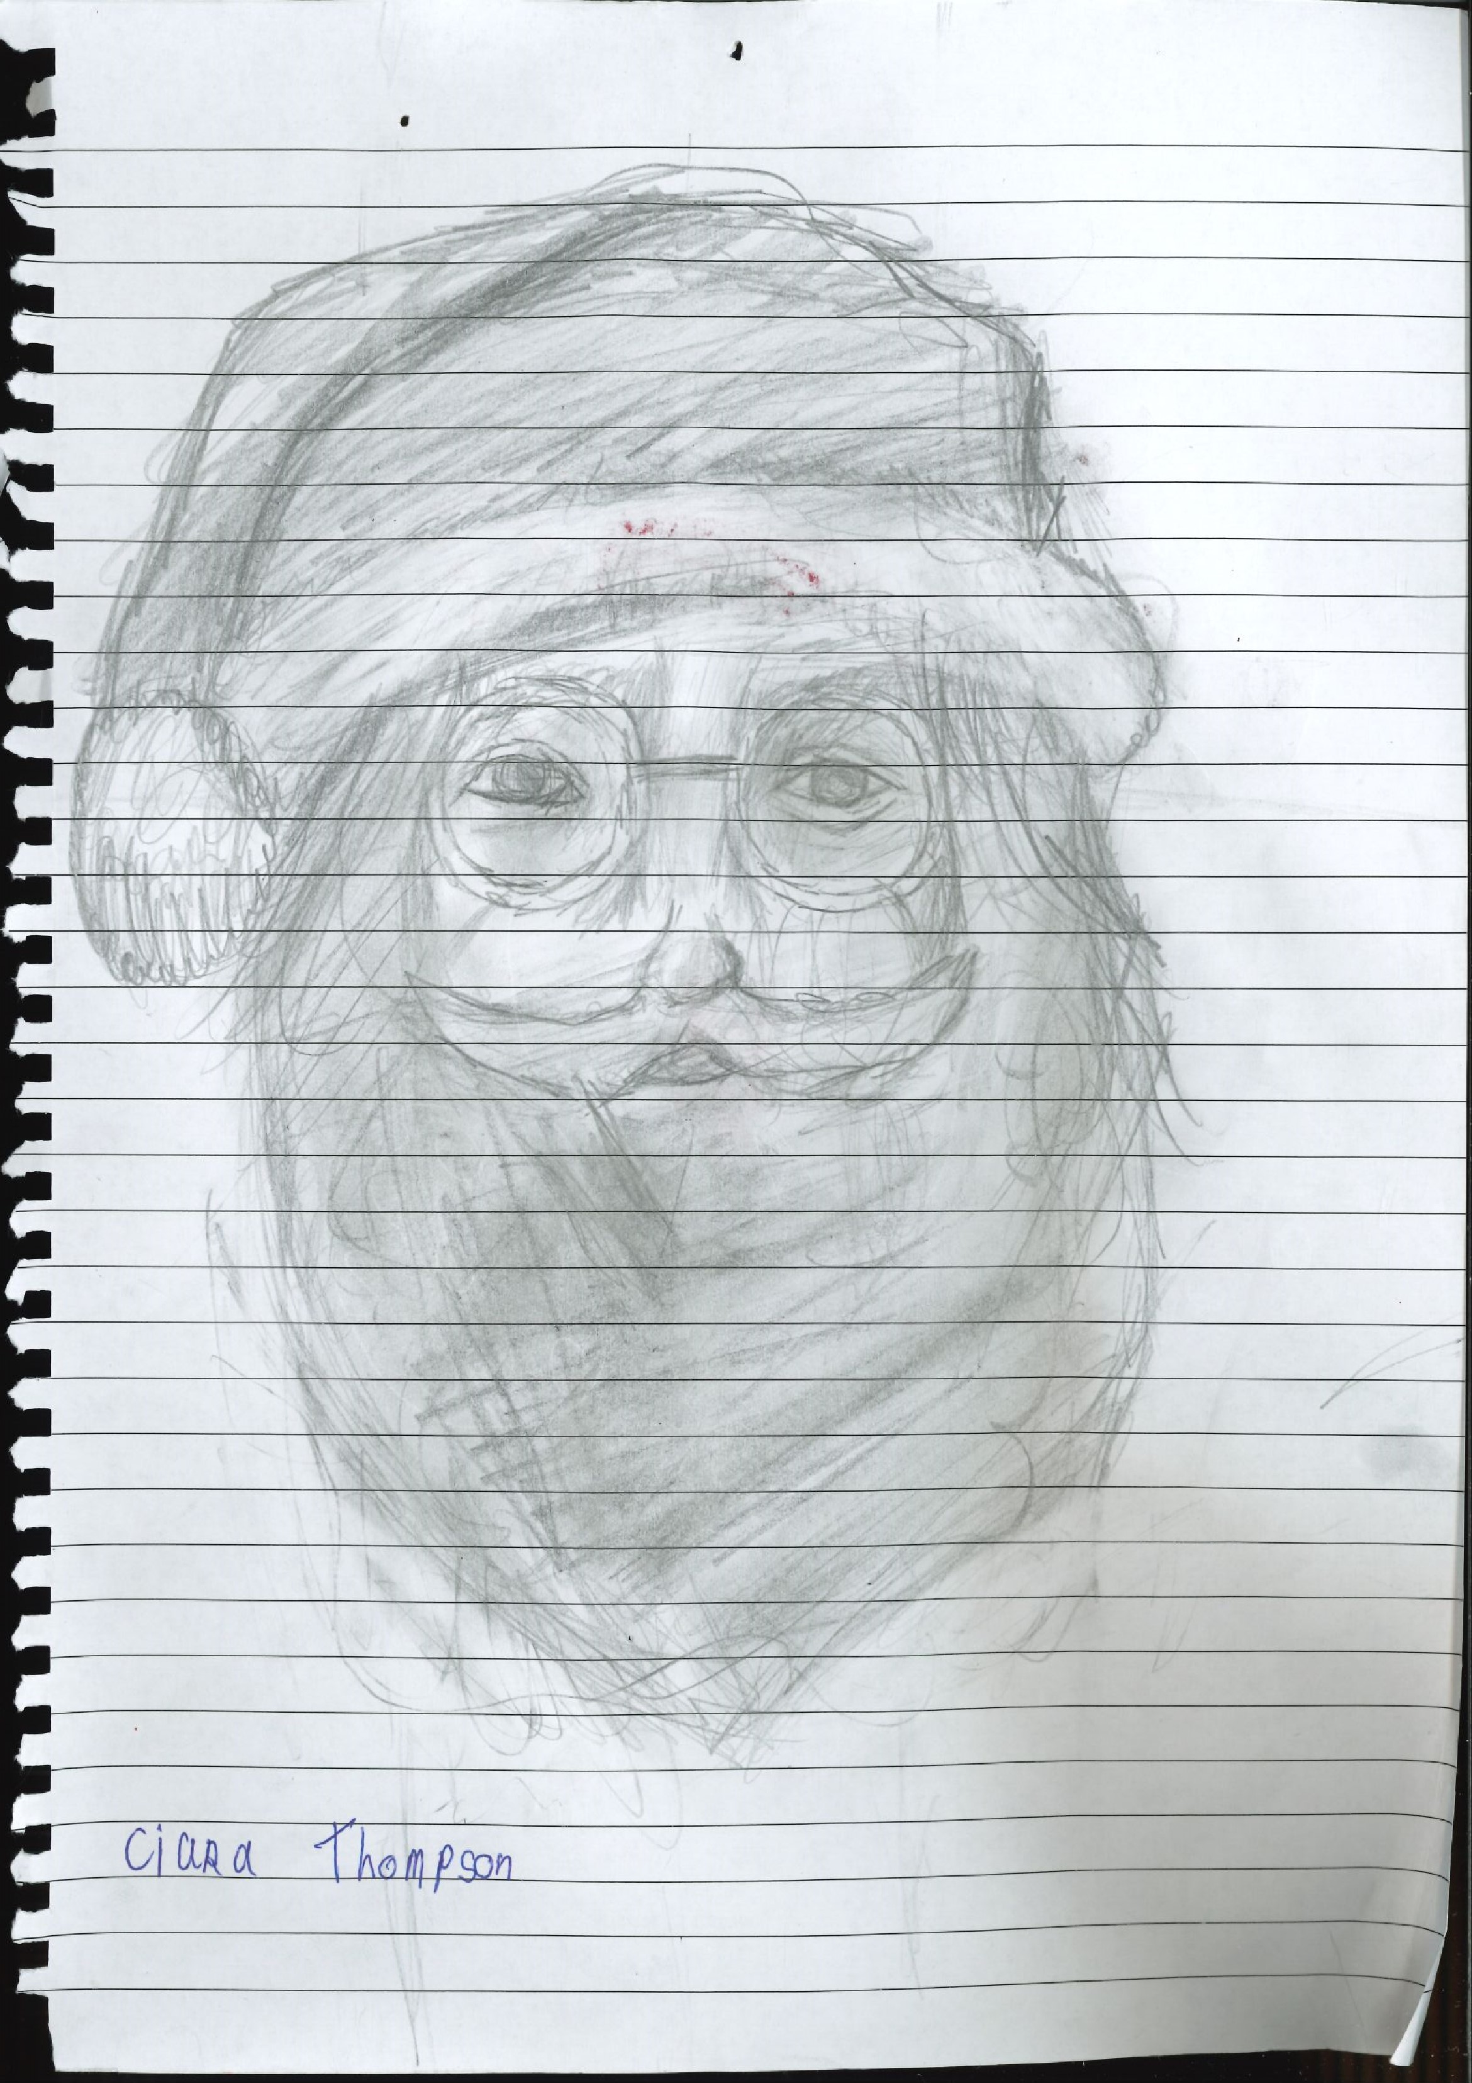

Slide 51
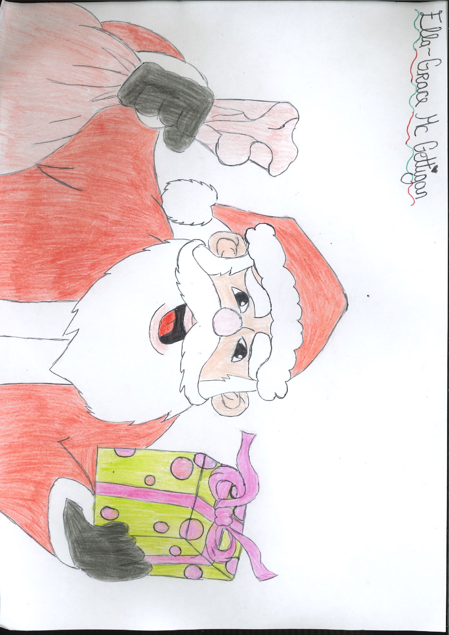

Slide 52
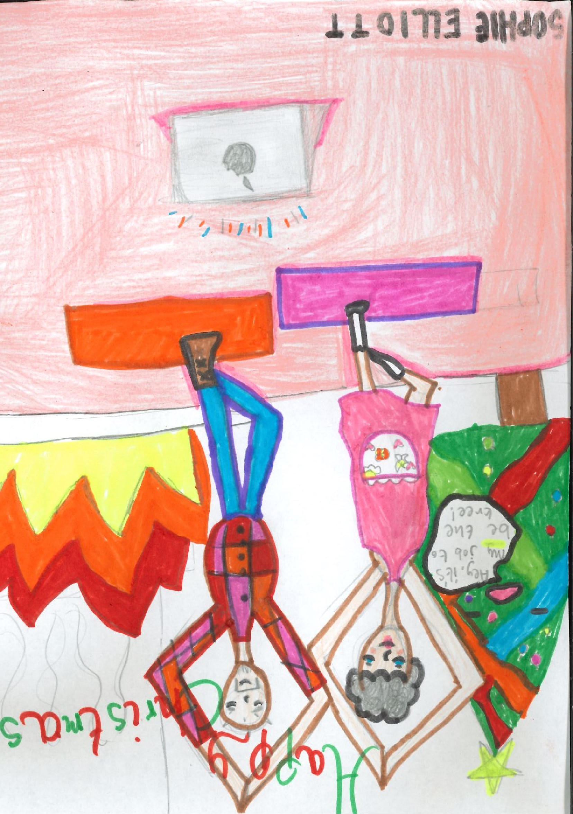

Slide 53
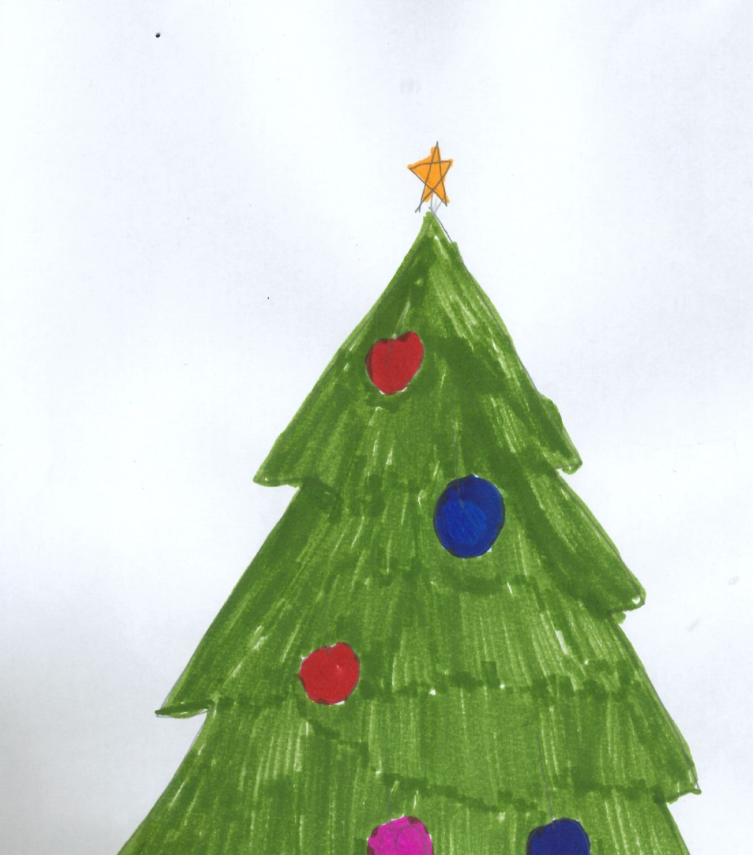
Abbie 1st Class

Slide 54
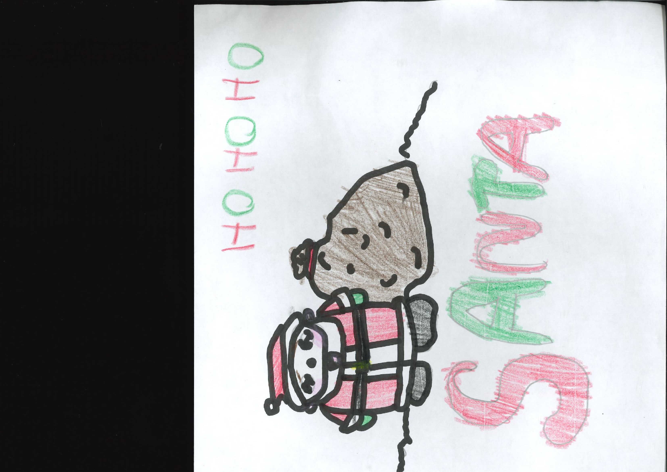

Slide 55
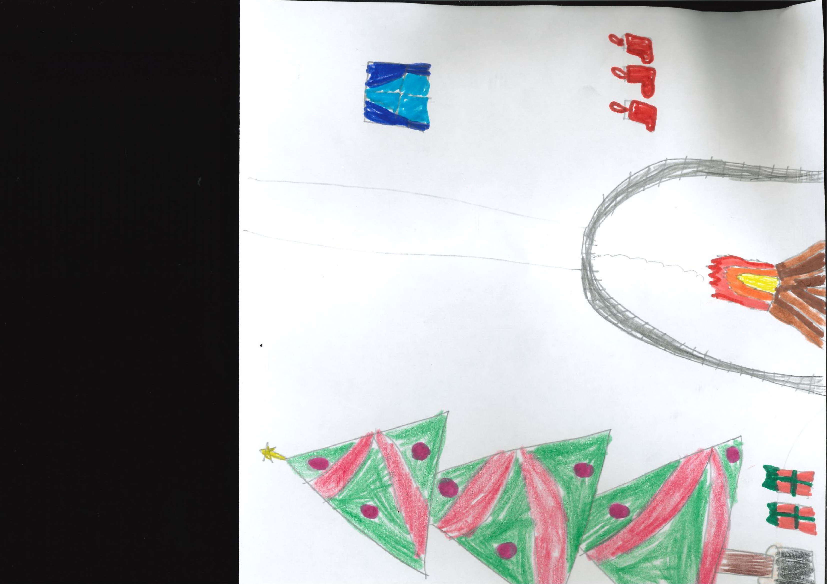

Slide 56
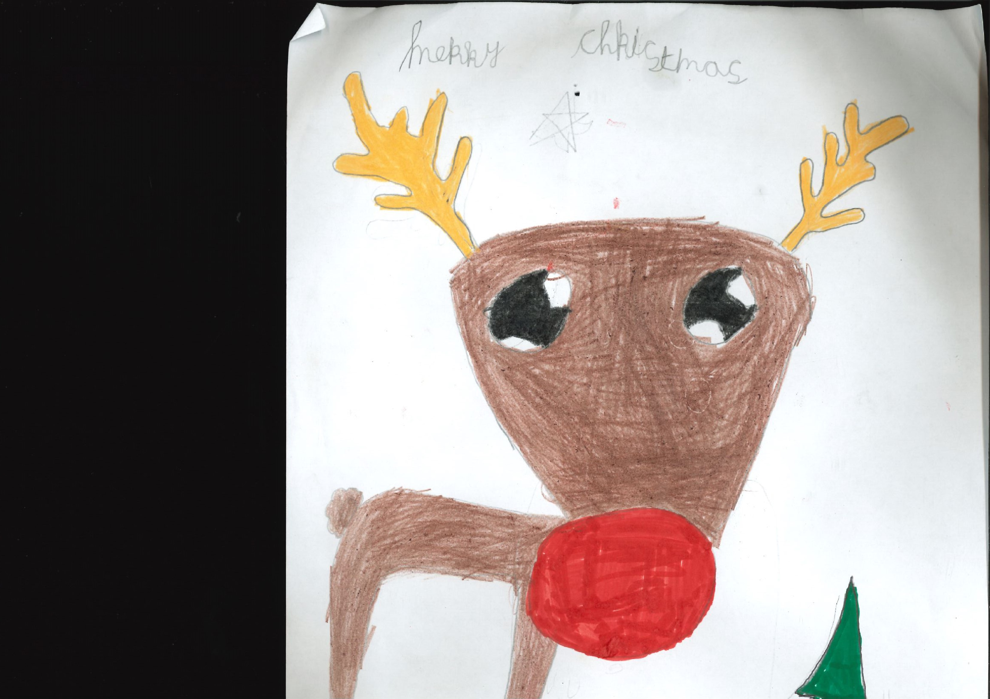
Sophie 2nd Class

Slide 57
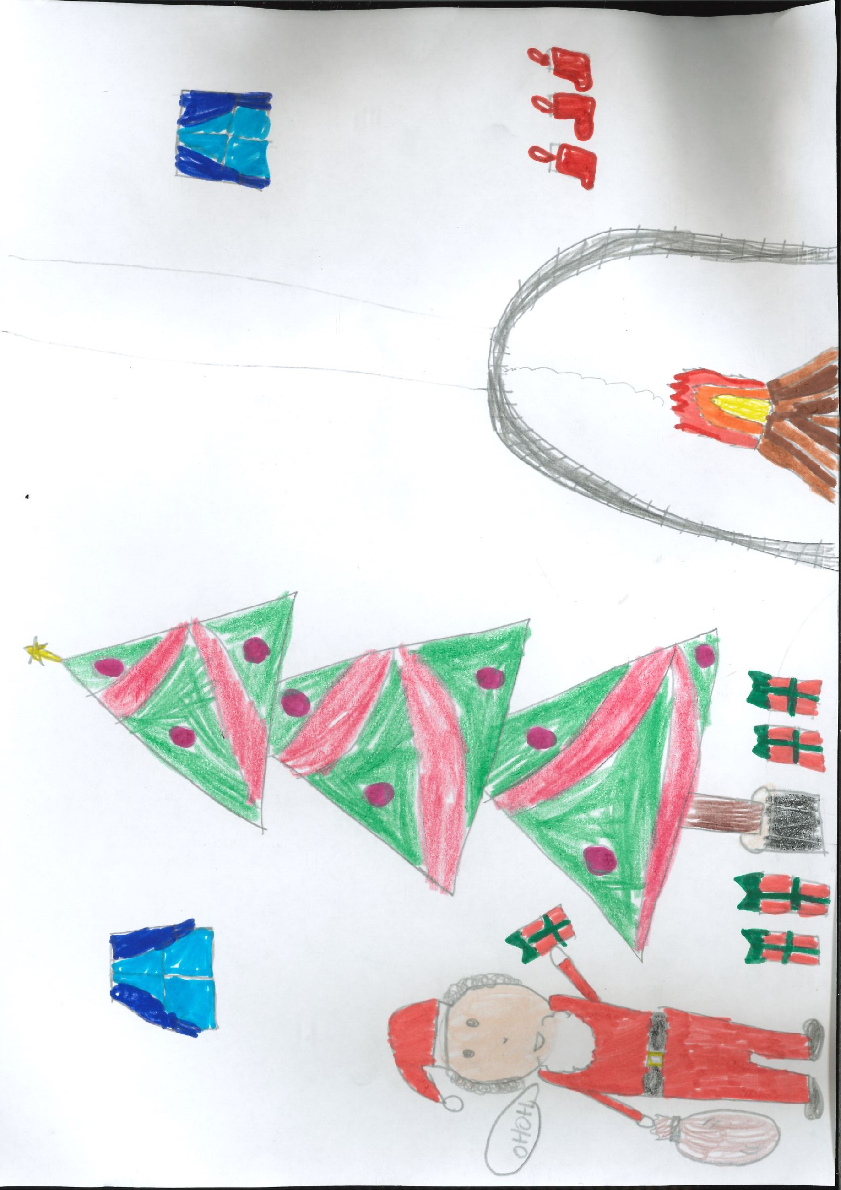

Slide 58
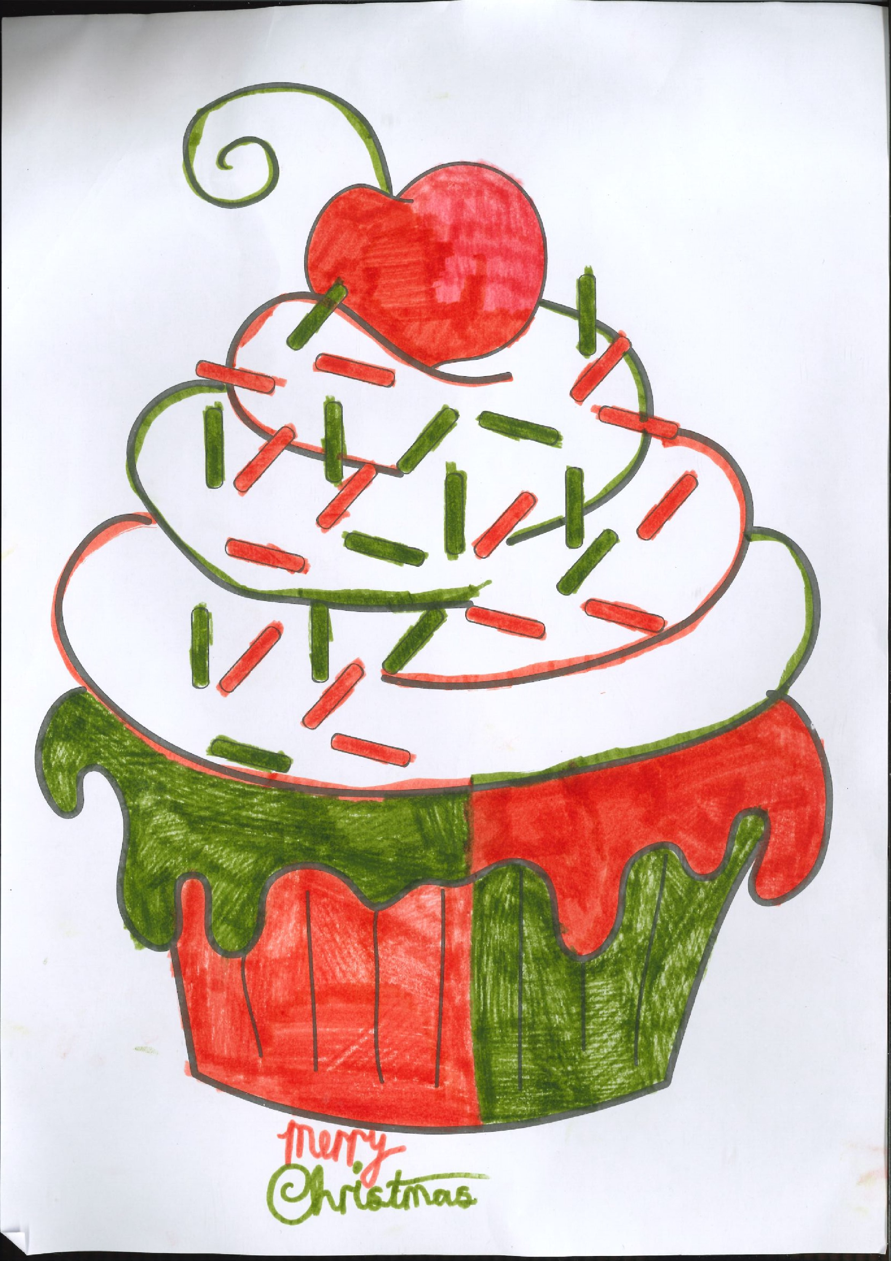

Slide 59
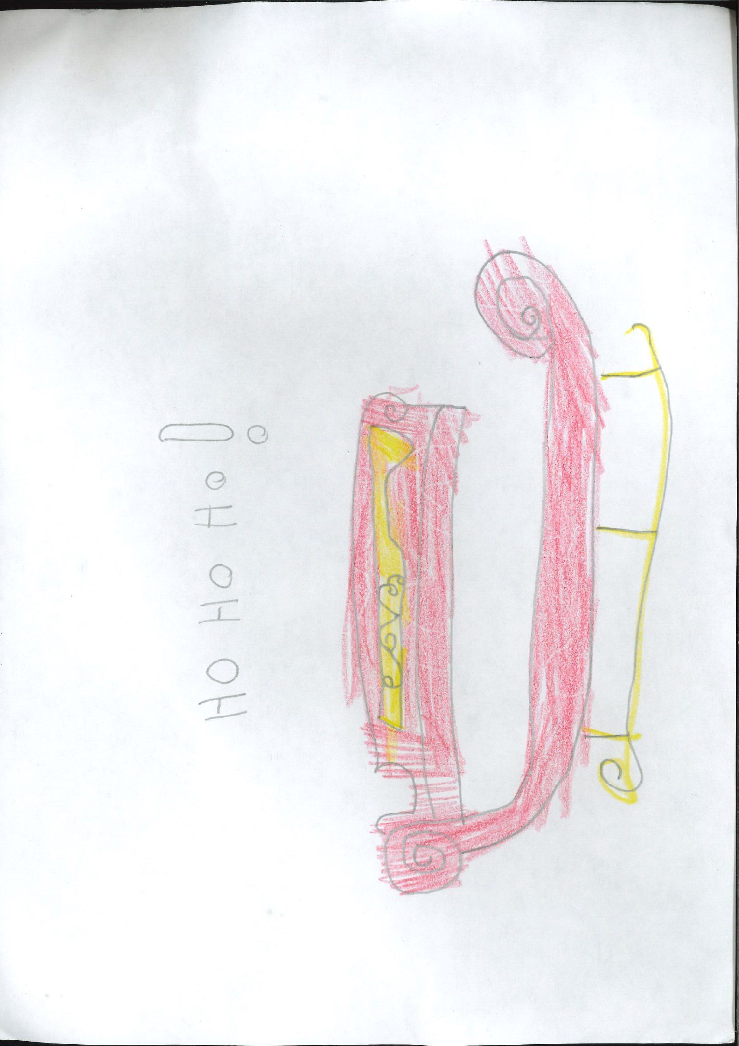

Slide 61
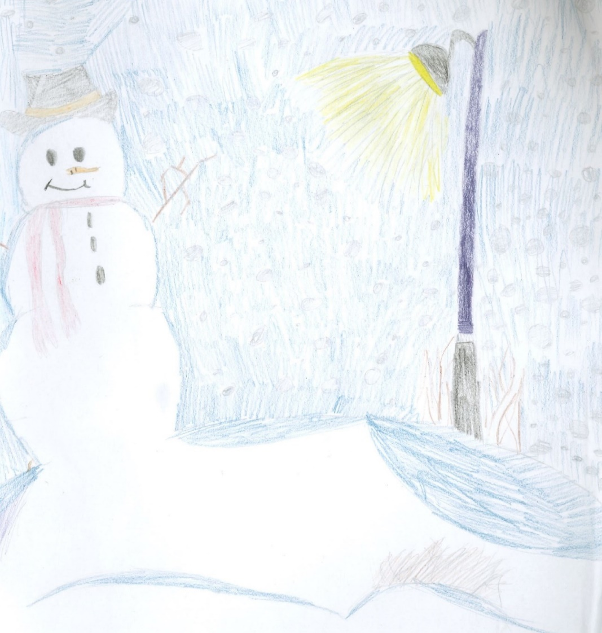
Olivia 5th Class

Slide 62
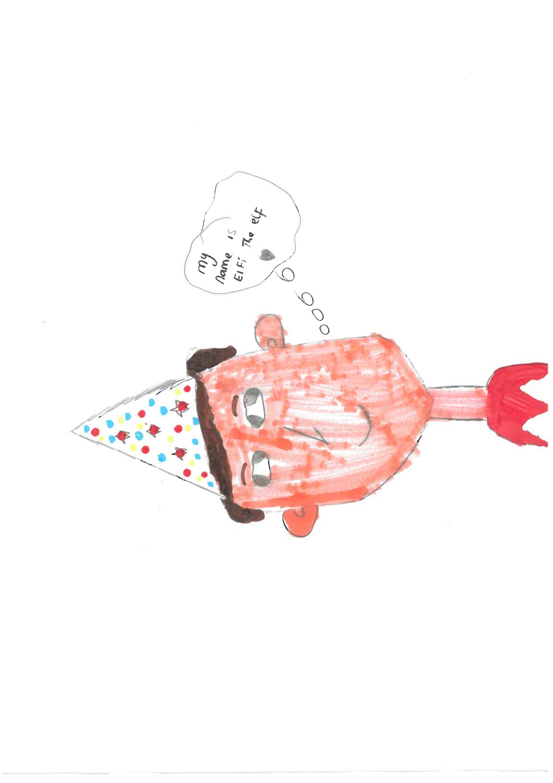
Ellie 4th Class

